Slide 1
Analysis
of
Bank Loan Data

Slide 2
Motivations
Businesses and individuals are constantly taking loans from banks to support their financial needs.
Bank loans have come a norm in developing business, improving personal lifestyle, and temporary solution for monetary problems.
There are huge number of people applying for loans, and banks collects their clients’ information to analyse before taking into consideration to approve the loan.
Bank has the responsibility to profit from loans and gives dividends to the clients who saved their money in the bank.

Slide 3
Questions
How does the banks form the data sets and analyse the information, in the process of justifying and approving the loans?
What type of information the banks require from their potential clients, and how they calculate the possibility of loaners repaying their loans?
What is the possible method that the bank process their clients’ data sets before finalizing with the result?

Slide 4
Data
Kaggle.com (https://www.kaggle.com/debudey/loan-default-logistic-regression-model/data)
Bank_Loan_data
5000 instances
20 attributes
Contains noise (missing value, erroneous value, incomplete value)
Attributes replaced by codes

Slide 5
Approach
Run in Anaconda Jupyter Notebook
Data Preprocessing and Exploration
Data Cleaning (replace noisy data; Mean and Mode)
Verification of Missing Values
Visualization (Categorical and Numerical Variables; Barplot & Boxplot)
Create Dummy Variables (for analyzing categorical variables)
Feature Selection - Recursive Feature Elimination (RFE)

Slide 6
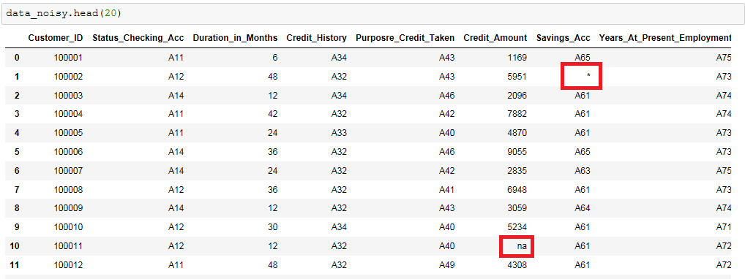
Before Data Cleaning

Slide 7
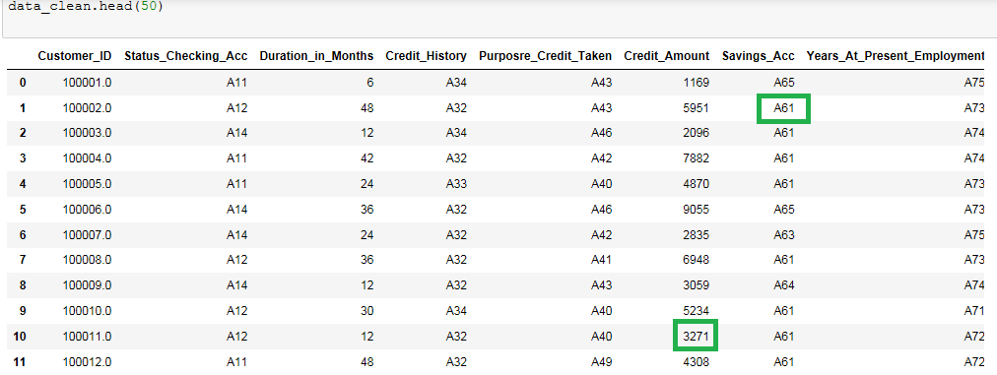
After Data Cleaning

Slide 8
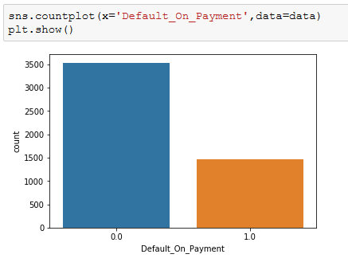
Visualization
Plot for visualising default on payment trend

Slide 9
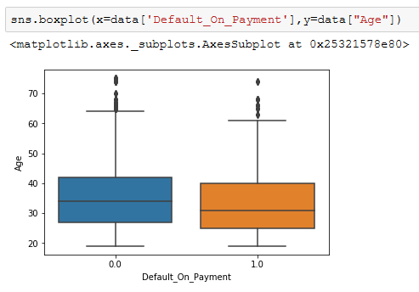
Visualization
Boxplot for visualising how age affects on default payment

Slide 10
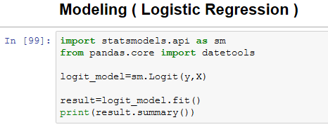
Modeling
Logistic Regression
Accuracy of Modeling (76%)

Slide 11
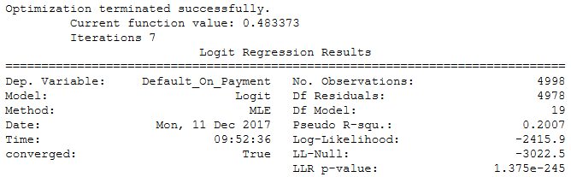
Modeling

Slide 12
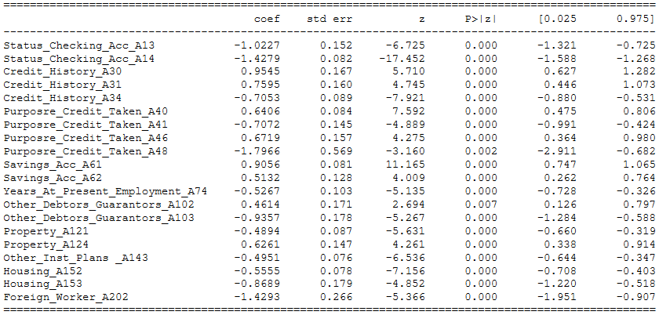
Modeling

Slide 13
Validation
K-Folds Cross-Validator
Train and Test method (70% train and 30% test)
10-Fold Cross-Validation Accuracy
Confusion Matrix
Classification Report

Slide 14
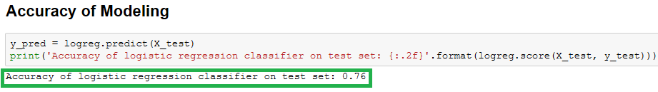
Result
Prediction is based on whether the applicant would be a defaulter or not (1 or 0)
K-Folds Cross-Validator - 76%

Slide 15
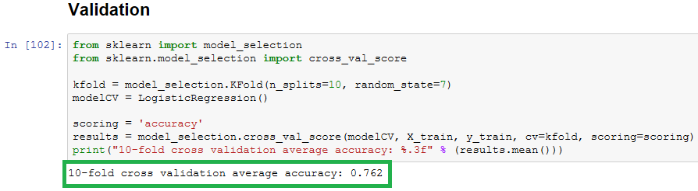
Result
10-Fold Cross-Validation Accuracy - 76.2%

Slide 16
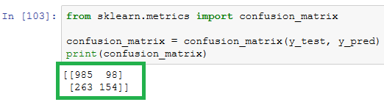
Result
Confusion Matrix Table

Slide 17
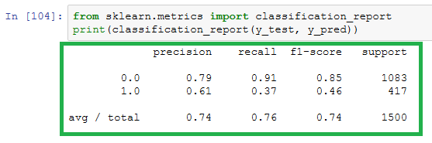
Result
Classification Report

Slide 18
Future Works
Different modeling techniques
Decision Tree, Naive Bayes, Random Forest etc
Different Feature Selection Method

Slide 19
No Implementation of Details
None

